Slide 1
PROJECT
MOVIE RENTAL DATA ANALYSIS

Slide 2
PROJECT OBJECTIVE
The objective of the project is to use MySQL to analyse the data of a movie rental store for further growth and improved business.
MOVIE RENTAL DATA ANALYSIS
Movie On Rent is a chain of movie rental stores operating in a certain country. It has a vast collection of movies in DVD and Blue Ray disc formats. The management of the company wants to analyse what kind of movies are most often rented, which genres they belong to, and which actors appeared in them. It will help the management stock up the inventory as per audience's preferences for improved business.

Slide 3
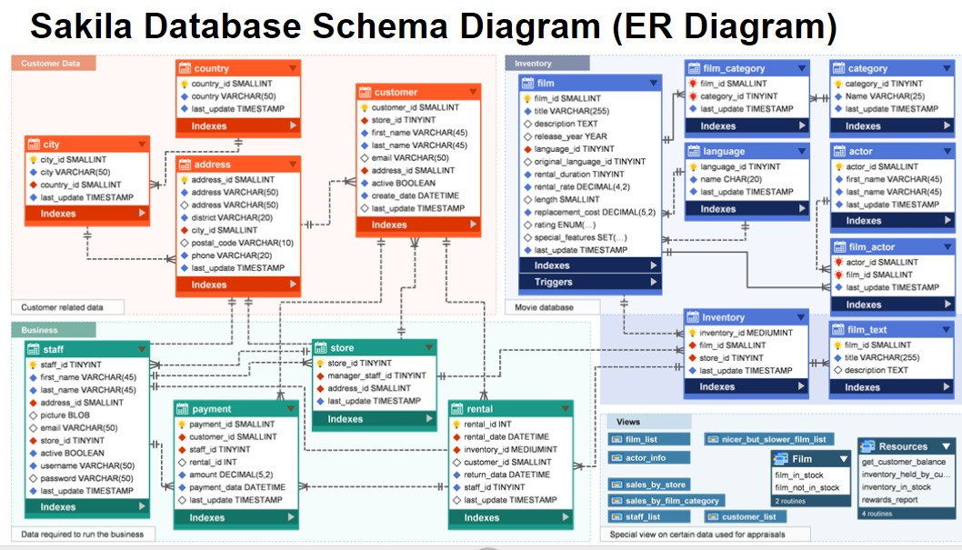
DATABASE SCHEMA DIAGRAM

Slide 4
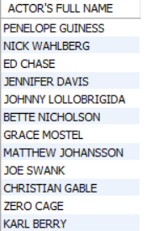
QUERY
TASK-1
Display the full names of actors available in the database.
Select concat(first_name," ",last_name) as "ACTOR'S FULL NAME" From actor;
RESULT OF QUERY
INTERPRETATION
There are 200 RECORDS of ACTORS with Full Name.

Slide 5
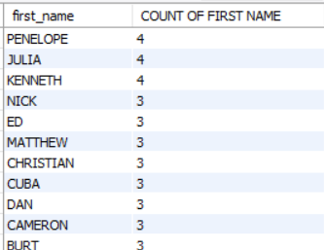
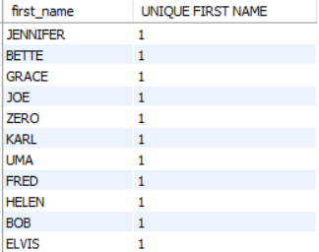
QUERY
TASK-2
Management wants to know if there are any names of the actors appearing frequently.
Display the number of times each first name appears in the database
What is the count of actors that have unique first names in the database? Display the first names of all these actors.
Select first_name, count(first_name) as "COUNT OF FIRST NAME" From actor group by first_name order by count(first_name) desc;
Select first_name, count(first_name) as "UNIQUE FIRST NAME" From actor group by first_name having count(first_name)=1 order by count(first_name);
RESULT OF QUERY
INTERPRETATION
There are Total 128 RECORDS OF FIRST NAME.
Like Penelope ,Julia and Kenneth is repeated 4 times .
There are Total 76 UNIQUE FIRST NAME.
Like ‘GRACE’,’JOE’,’ZERO’,’KARL’,’UMA’ which are not Repeated and unique First Name.

Slide 6
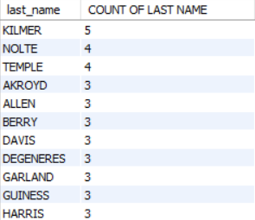
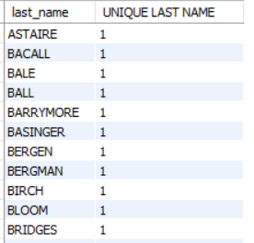
QUERY
TASK-3
Task 3: The management is interested to analyse the similarity in the last names of the actors.
Display the number of times each last name appears in the database.
Display all unique last names in the database.
Select last_name, count(last_name) as "COUNT OF LAST NAME" From actor group by last_name order by count(last_name) desc;
Select last_name, count(last_name) as "UNIQUE LAST NAME" From actor group by last_name having count(last_name)=1 order by count(last_name);
RESULT OF QUERY
INTERPRETATION
There are 121 RECORDS OF LAST NAME.
Like ‘KILMER’,’NOLTE’,’TEMPLE’ is repeated 5 and 4 times.
There are Total 66 UNIQUE LAST NAME.
Like ‘BALE’,’BALL’,’BLOOM’,’CRUZ’,’DAMON’ which are not Repeated and unique Last Name.

Slide 7
QUERY
TASK-4
The management wants to analyse the movies based on their ratings to determine if they are suitable for kids or some parental #assistance is required. Perform the following tasks to perform the required analysis.
Display the list of records for the movies with the rating "R". (The movies with the rating "R" are not suitable for audience under #17 years of age).
Display the list of records for the movies that are not rated "R".
Display the list of records for the movies that are suitable for audience below 13 years of age.
Select film_id,title,rating from film where rating="R";
Select film_id,title,rating from film where rating!="R“;
Select film_id,title,rating from film where rating="PG-13";

Slide 8
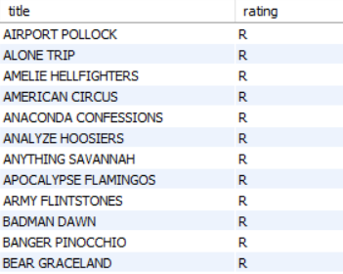
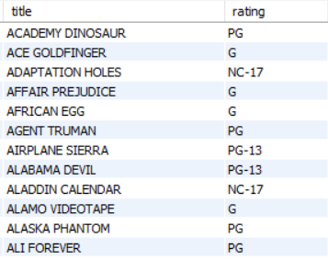
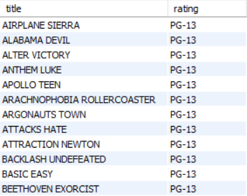
INTERPRETATION
RESULT OF QUERY
There are Total 195 Movies which belongs to R RATING.
There are Total 805 Movies Which belongs to PG,G,NC-17,PG-13 RATING.
194 Movies which belongs to PG RATING.
178 Movies which belongs to G RATING.
210 Movies which belongs to NC-13 RATING.
223 Movies which belongs to PG-13 RATING.

Slide 9
QUERY
TASK-5
Task 5: The board members want to understand the replacement cost of a movie copy(disc - DVD/Blue Ray).The replacement cost refers to the amount charged to the customer if the movie disc is not returned or is returned in a damaged state.
Display the list of records for the movies where the replacement cost is up to $11.
Display the list of records for the movies where the replacement cost is between $11 and $20.
Display the list of records for the all movies in descending order of their replacement costs.
Select film_id,title,replacement_cost from film where replacement_cost<=11;
Select film_id,title,replacement_cost from film where replacement_cost between 11 and 20;
Select film_id,title,replacement_cost from film order by replacement_cost desc;

Slide 10
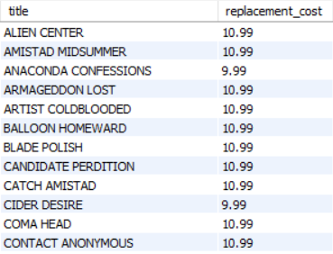
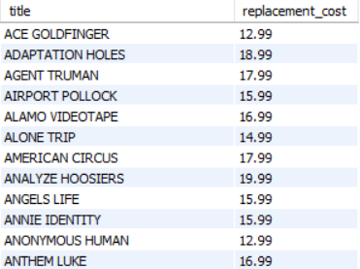
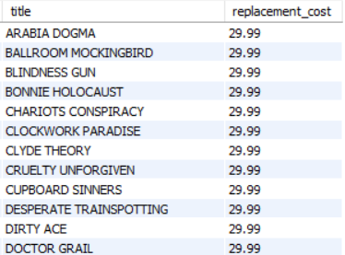
INTERPRETATION
RESULT OF QUERY
There are Total 90 Movies where replacement cost is less than 11.
Total 49 movies where replacement cost is 10.99
Total 41 Movies where replacement cost is 9.99
There are TOTAL 424 Movies where replacement cost is between 11 and 20.
There are Total 1000 Movies, the Maximum Replacement cost is 29.99 and Minimum Replacement cost is 9.99

Slide 11
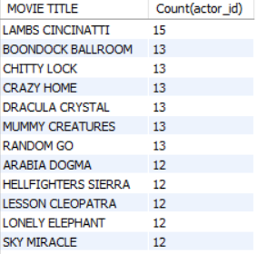
QUERY
TASK-6
Display the names of the top 3 movies with the greatest number of actors.
CREATE VIEW COUNT_OF_ACTOR AS Select title as "MOVIE TITLE",Count(actor_id) from film inner join film_actor on film_actor.film_id=film.film_id group by title order by count(actor_id) desc ;
SELECT *FROM COUNT_OF_ACTOR;
INTERPRETATION
RESULT OF QUERY
There are only 997 RECORDS OF MOVIES NAME.
LAMBS CINCINATTI have the HIGHEST NO OF ACTOR WORK IN THIS MOVIE.
LIKE ‘BAKED CLEOPATRA’,’DOLLS RAGE’,’MOON BUNCH’,SHOCK CABIN’ have only 1 ACTOR WORKED In this MOVIE and many more.

Slide 12
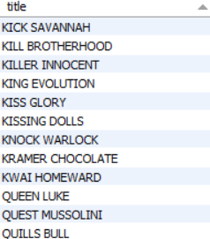
QUERY
TASK-7
'Music of Queen' and 'Kris Kristofferson' have seen an unlikely resurgence. As an unintended consequence, films starting with #the letters 'K' and 'Q' have also soared in popularity. Display the titles of the movies starting with the letters 'K' and 'Q.
select title from film where title like "K%" or title like "Q%" ;
RESULT OF QUERY
INTERPRETATION
There are Total 15 MOVIES which are starting with K and Q.
There are 12 MOVIES which are starting with K.
There are only 3 MOVIES which starting with Q.

Slide 13
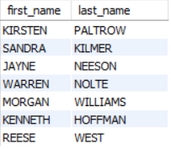
QUERY
TASK-8
The film 'Agent Truman' has been a great success. Display the names of all actors who appeared in this film.
CREATE VIEW SEARCH_AGENT_TRUMAN AS
Select first_name,last_name from film inner join film_actor on film_actor.film_id=film.film_id inner join actor on actor.actor_id=film_actor.actor_id where title="AGENT TRUMAN“ ;
SELECT *FROM SEARCH_AGENT_TRUMAN;
INTERPRETATION
There are only 7 ACTORS who are working in ‘AGENT TRUMAN’ Movie.
It contains First name and Last name of all 7 Actors.
RESULT OF QUERY

Slide 14
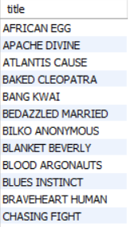
QUERY
TASK-9
Sales have been lagging among young families, so the management wants to promote family movies. Identify all the movies categorized as family films.
CREATE VIEW FAMILY_MOVIES AS
select title from film inner join film_category on film_category.film_id=film.film_id inner join category on film_category.category_id=category.category_id where name='family’;
SELECT *FROM FAMILY_MOVIES;
INTERPRETATION
RESULT OF QUERY
There are only 69 movie which are Belongs To ‘FAMILY GENRE’.

Slide 15
QUERY
TASK-10
The management wants to observe the rental rates and rental frequencies (Number of time the movie disc is rented).
Display the maximum, minimum, and average rental rates of movies based on their ratings. The output must be sorted in descending order of the average rental rates.
Display the movies in descending order of their rental frequencies, so the management can maintain more copies of those movies.
CREATE VIEW RATING AS Select rating,max(rental_rate),min(rental_rate),avg(rental_rate) from film group by rating;
SELECT *FROM RATING;
CREATE VIEW FREQUENCY_RENTED AS select film_id,title,count(inventory_id) as 'FREQUENTLY RENTED' from film join inventory using (film_id)join rental using (inventory_id) group by film_id order by count(inventory_id) desc ;
SELECT *FROM FREQUENCY_RENTED;

Slide 16
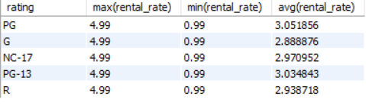
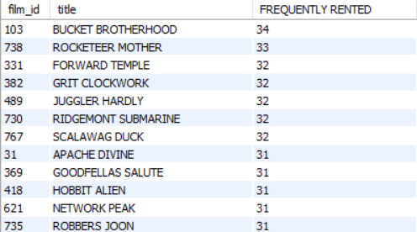
INTERPRETATION
RESULT OF QUERY
The Maximum Rental rate is 4.99 and Minimum Rental Rate is 0.99 for all the Rating ( PG,G,NC-17,PG-13,R)
The Average Rental Rate Range is 2.5 to 3.10
There are TOTAL 958 MOVIES which are FREQUENTLY RENTED.
Like ‘Bucket Brotherhood’,’Roceteer Mother’ are Frequently Rented 34 and 33 times.
‘Traffic Hobbit’ and ‘Hardly Robbers’ are least Frquently Rented Movies that is 5 and 4 times

Slide 17
QUERY
TASK-11
In how many film categories, the difference between the average film replacement cost ((disc-DVD/Blue Ray) and the average film rental rate is greater than $15?
Display the list of all film categories identified above, along with the corresponding average film replacement cost and average film rental rate.
CREATE VIEW AVERAGE AS select name , avg((replacement_cost)-(rental_rate)) as 'GREATER THAN 15' , count(title) as "NO OF MOVIES" from film inner join film_category on film_category.film_id=film.film_id inner join category on category.category_id=film_category.category_id group by name having avg((replacement_cost)-(rental_rate)) >=15 order by count(title) desc;
SELECT *FROM AVERAGE;
CREATE VIEW ALL_AVERAGE AS select name , avg(replacement_cost),AVG(rental_rate), count(title) as
"NO OF MOVIES" from film inner join film_category on film_category.film_id=film.film_id inner join category on category.category_id=film_category.category_id group by name order by count(title) desc;
Select *from ALL_AVERAGE;

Slide 18
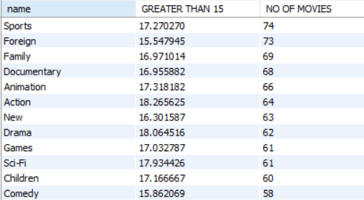
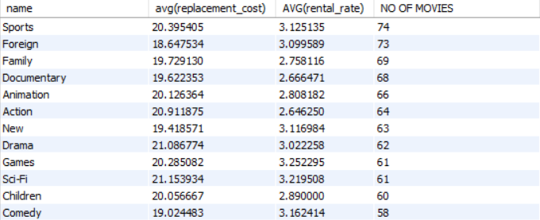
INTERPRETATION
RESULT OF QUERY
There are 16 Genres where Average Replacement cost and Rental Rate is Greater than 15.
There are Total 16 Genres ,Maximum Average Replacement cost is Approx. 22 and Minimum Average Replacement cost is Approx. 18
The Maximum Average Rental Rate is approx. 3.5 and Minimum Average Rental Rate is approx. 2.5

Slide 19
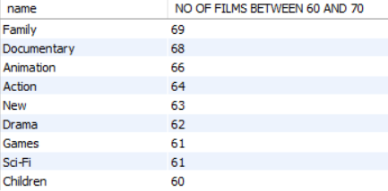
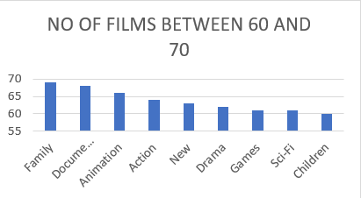
QUERY
TASK-12
Display the film categories in which the number of movies is greater than 70.
CREATE VIEW COUNT_OF_MOVIES AS select name , count(film_id) as 'NO OF FILMS BETWEEN 60 AND 70' from film_category inner join category on category.category_id=film_category.category_id group by name having count(film_id) between 60 and 70ORDER BY count(film_id) desc ;
SELECT *FROM COUNT_OF_MOVIES;
INTERPRETATION
There are 9 GENRE only where count of movies lie between 60 and 70.
FAMILY GENRE AND DOCUMENTARY GENRE have the HIGHEST COUNT OF MOVIES that’s 69 and 68 movies.
CHILDREN GENRE , SCI-FI and GAMES GENRE have the Least Count of movies that’s 60,61 and 61 movies.
RESULT OF QUERY

Slide 20
CONCLUSION
A total of 200 actors are with Sakila rental store collection. There are 17 genres and mainly 5 types of ratings. There are 3 first names - Penelope, Julia and Kenneth that are repeated the most. There are 3 last names Kilmore, Nolte and temple that are repeated the most.
Rating PG-13 has the highest and rating G has the lowest no of movies ,rating G has the lowest average rental rate of 2.88 and rating PG ha the highest average rental rate of 3.05 There are total 214 movies who has replacement cost between 15$ and 20$. There are total 22 movies where the replacement cost is 29.99 $ as highest and rental rate 0.99$ lowest.
Movie title lambs Cincinnati has the most no of actors working i.e.:-15 .There are total 7 actors in movie Agent Truman which was a great success.
There are total 69 movies in the family genre that could be liked by children as well. Most frequently rented movies are bucket brotherhood, rocketeer mother, and forward temple.
All genres were having average of (difference btw replacement cost and rental rate ) greater than 15.There are total 9 genres consisting no of movies between 60-70, where children genre has the least and family genre has the most no of movies.

Slide 21
THANK YOU
VIPUL GOUR

